Slide 1
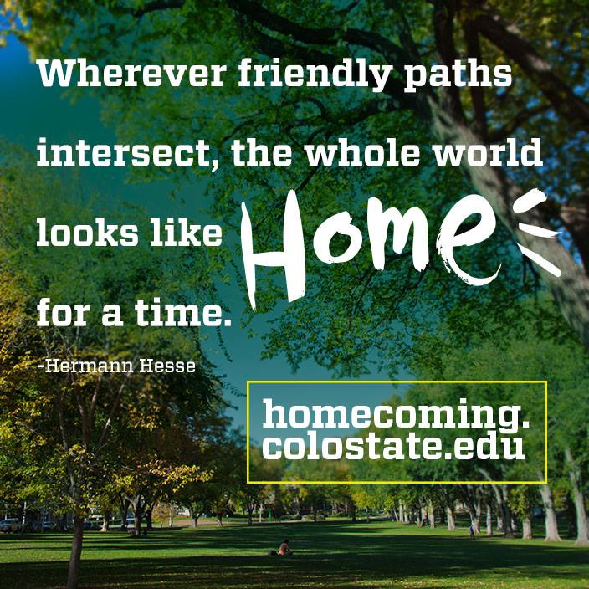

Homecoming 2015

Slide 2
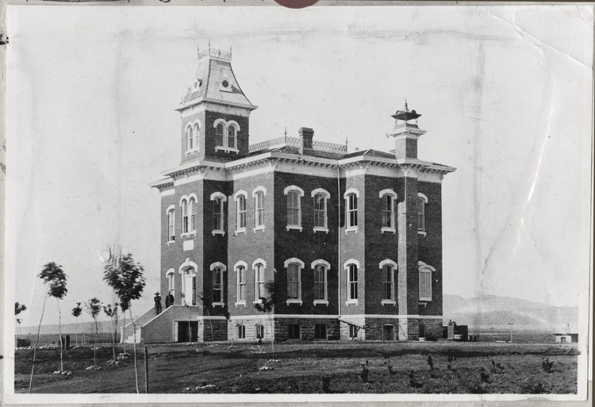
1879 - Colorado State Agricultural College is born, twenty students and three professors. (Old Main building, 1880)

Slide 3
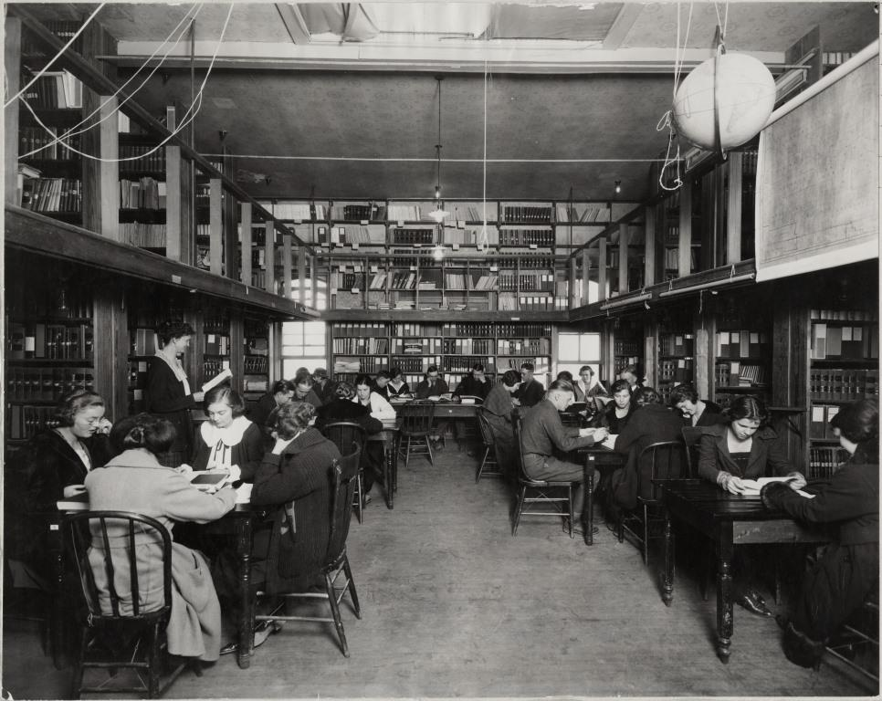
1886 - Elizabeth G. Bell is the first English professor hired by the college.
1929 - There are twelve English faculty members. (English class in the Library, 1921).

Slide 4
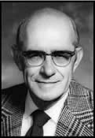
1939 - Willard O. Eddy is hired as an instructor in English, and History and English are separated into two distinct departments. By 1945, there are thirteen English faculty members. (Willard O. Eddy)

Slide 5
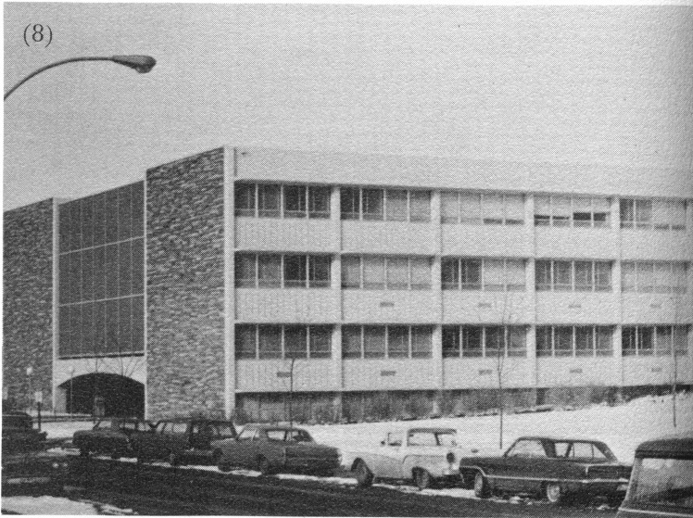
1963 - The original Eddy Hall is constructed, a 69,457 square-foot building. (Eddy Hall, then called Liberal Arts,1968)

Slide 6
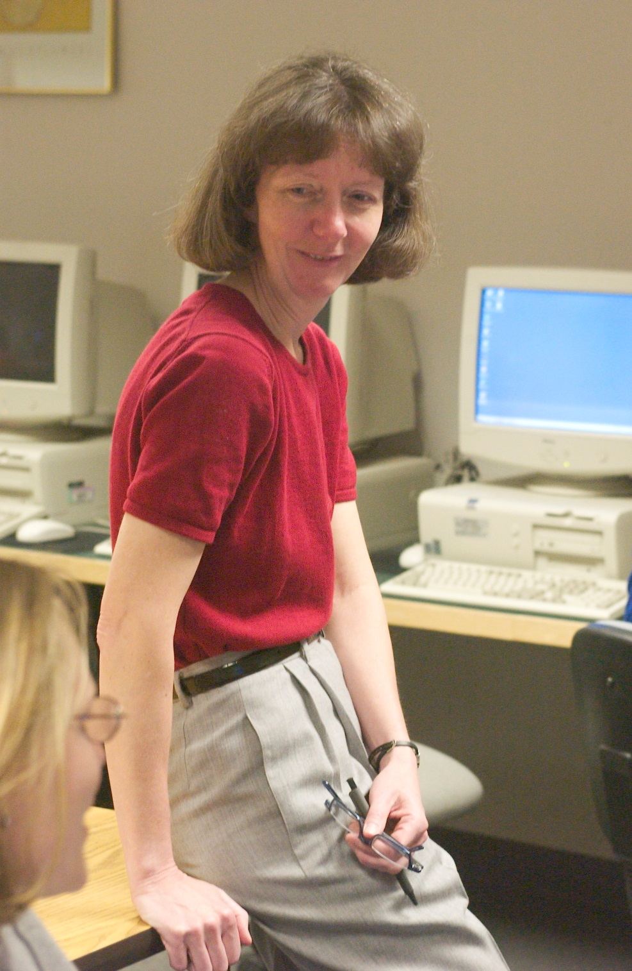
1977- English faculty number 41 and 90 courses are offered.
1979 - Kate Keifer establishes the Writing Center.
1981- Colorado State University is the first in the nation to create a computer-supported writing laboratory.
(Kate Kiefer works with students in her writing for the sciences class, April 2003.)

Slide 7
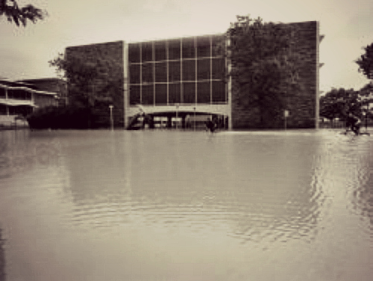
1997- The infamous Fort Collins floodwaters rip through Eddy Hall. (Water surrounds the Eddy Building, 1997).

Slide 8
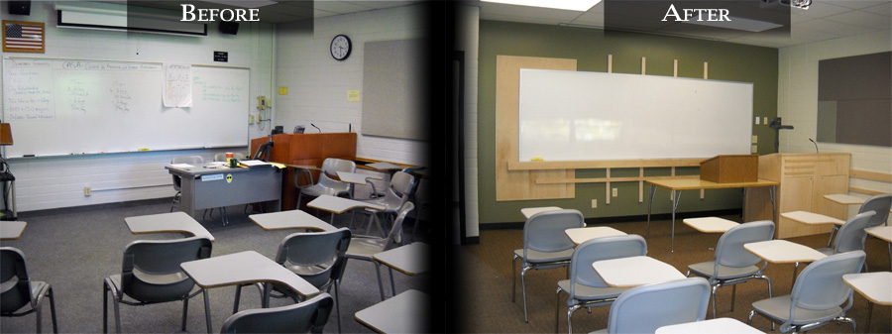
2011 – A $3 million upgrade focused on classroom and energy efficiency upgrades, (A classroom in Eddy, before and after).

Slide 9
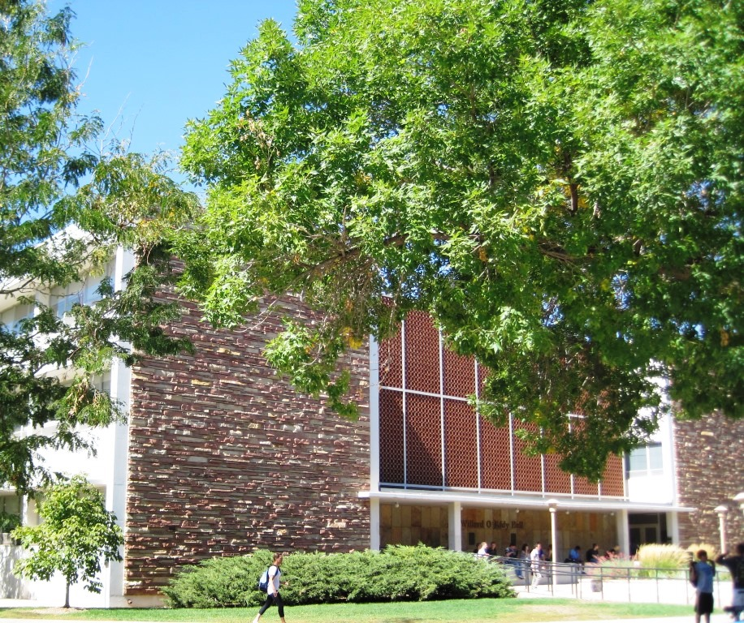
Eddy Hall, 2010
Eddy Hall has never undergone a major renovation during its 51-year lifespan…
Until now.

Slide 10
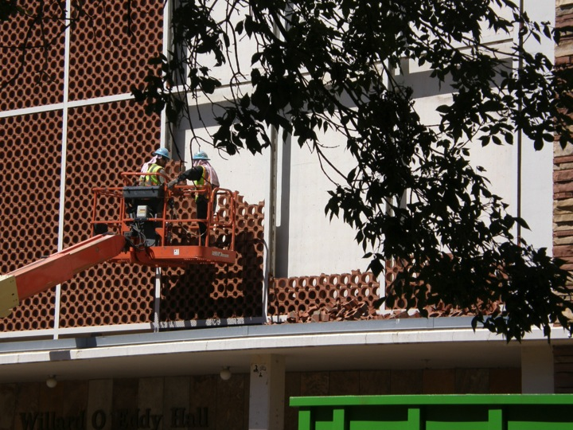
Front of Eddy Hall, August 2014

Slide 11
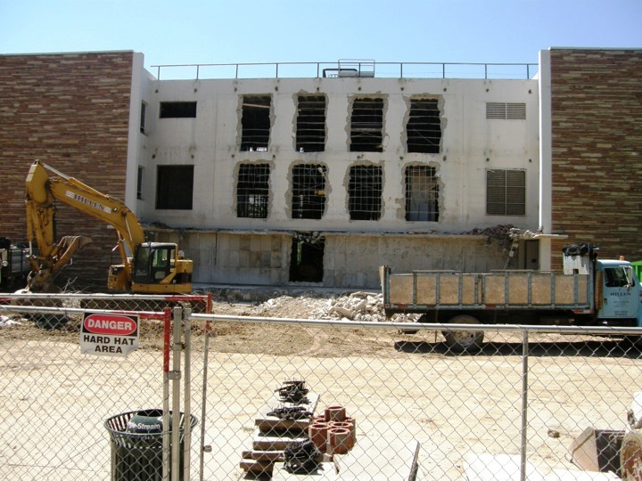
Front of Eddy Hall, August 2014

Slide 12
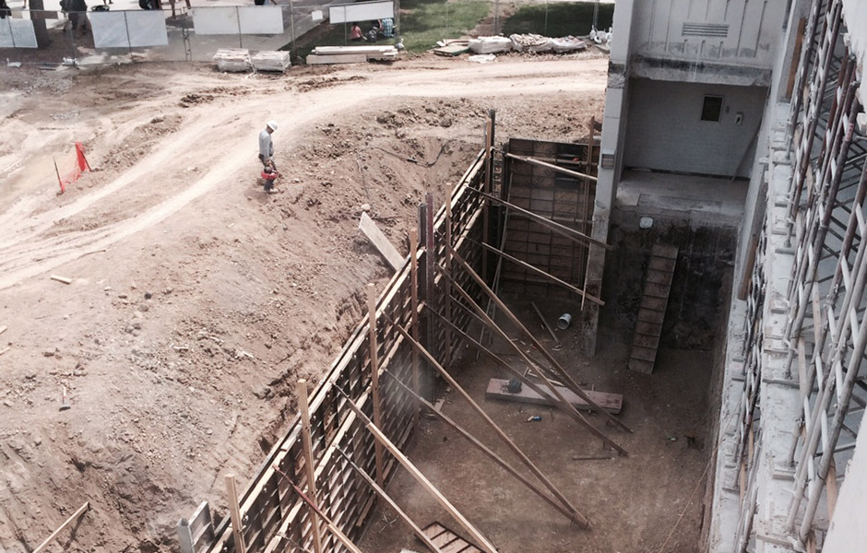
Front of Eddy Hall, September 2014

Slide 13
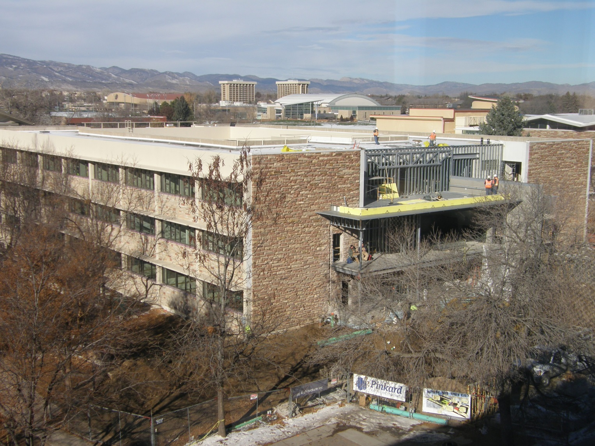
Front of Eddy Hall, November 2014

Slide 14
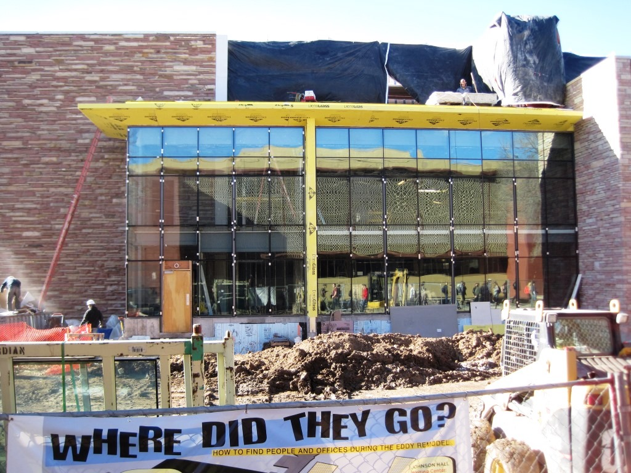
Front of Eddy Hall, January 2015

Slide 15
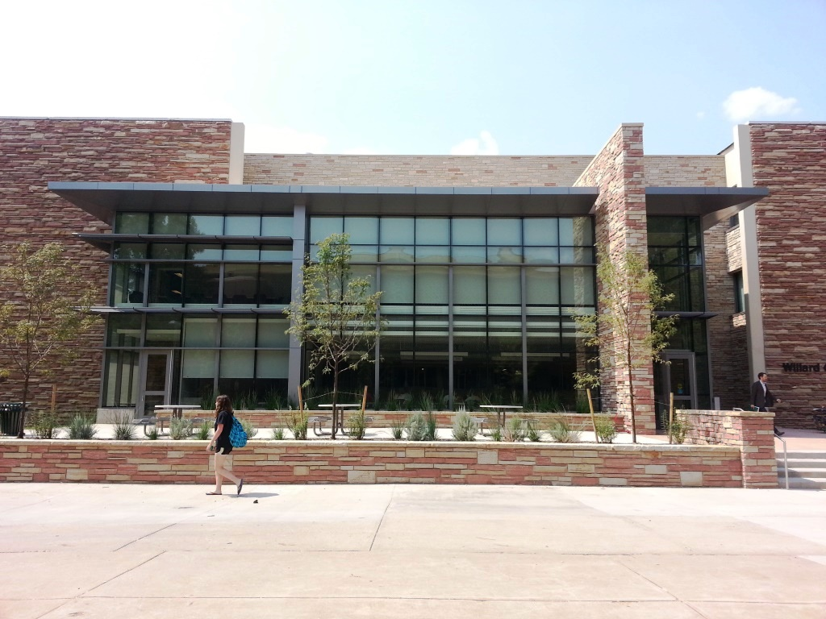
Front of Eddy Hall, September 2015 - Renovations complete!

Slide 16
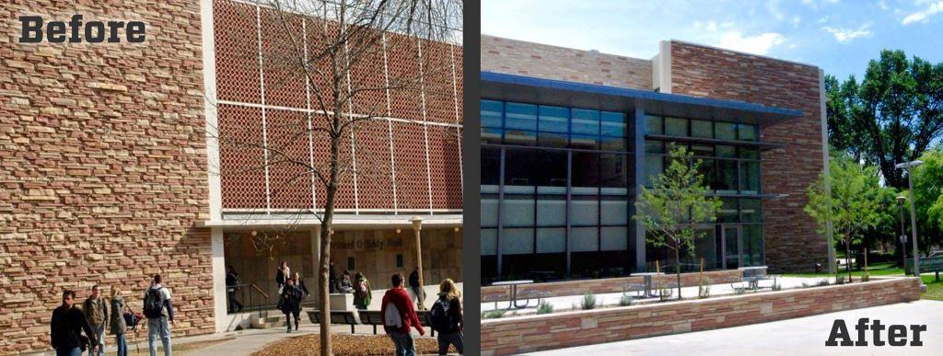
Eddy front - Before and After

Slide 17
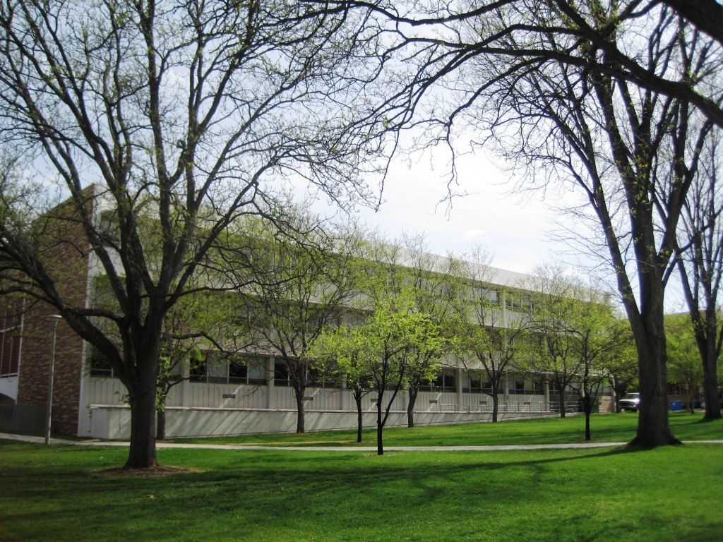
South side of Eddy – Before

Slide 18
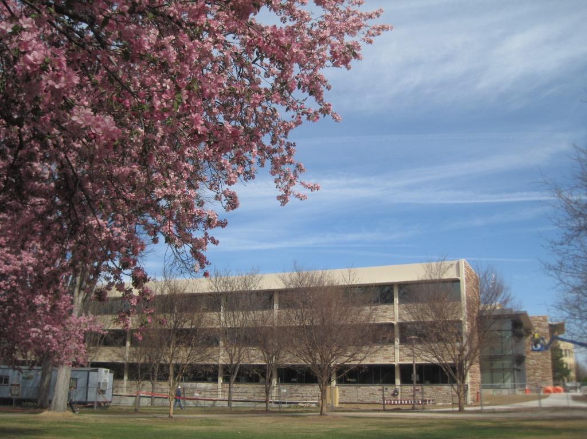
South side of Eddy – During construction

Slide 19
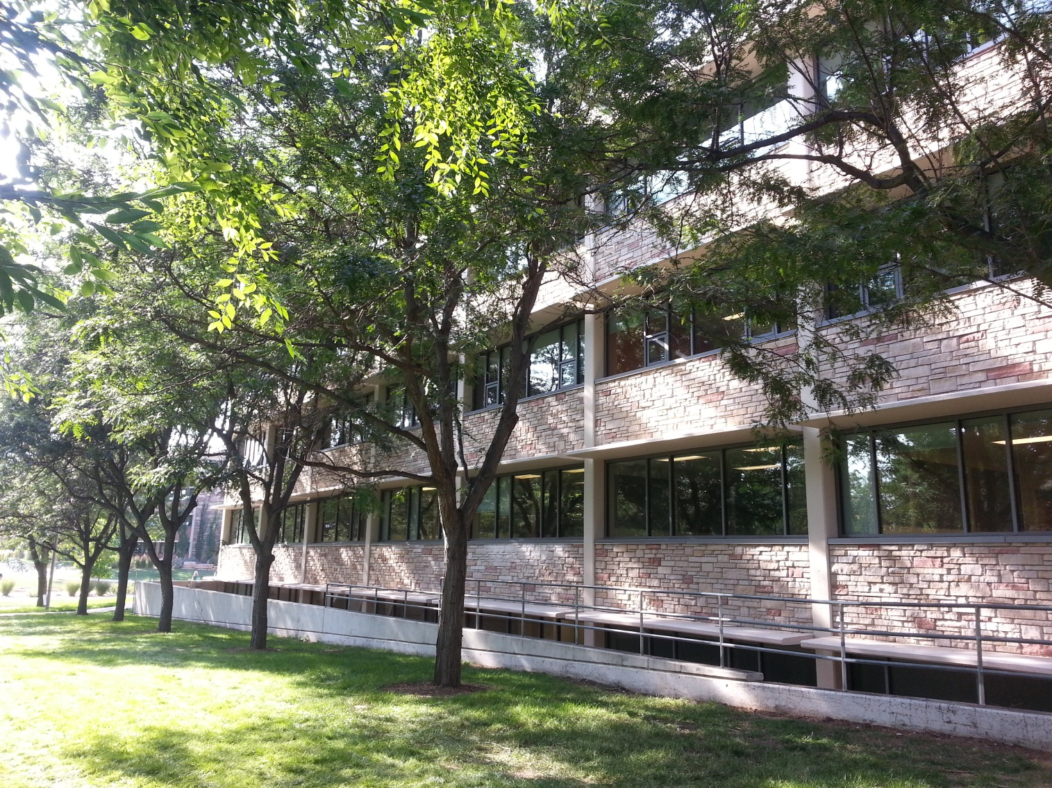
South side of Eddy – After

Slide 20
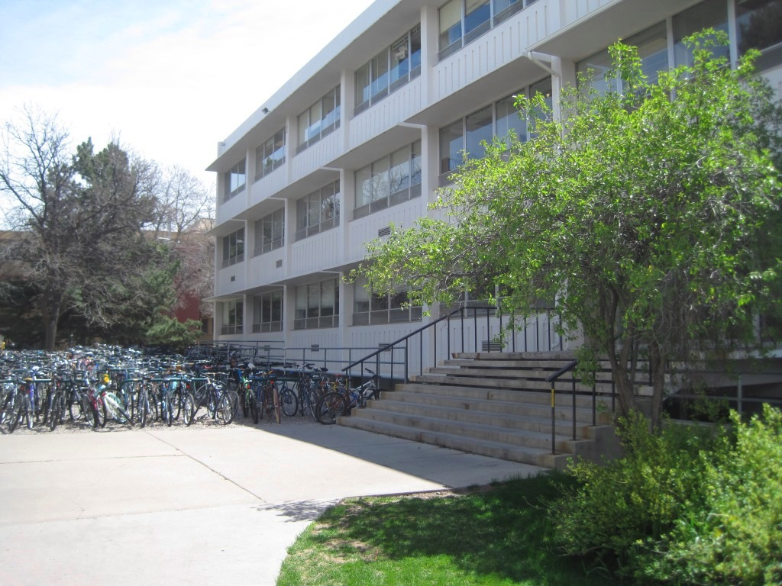
North side of Eddy - Before

Slide 21
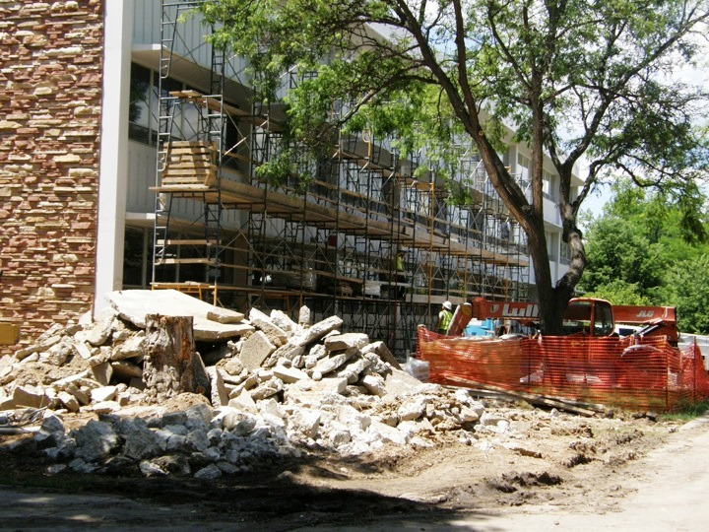
North side of Eddy – During construction

Slide 22
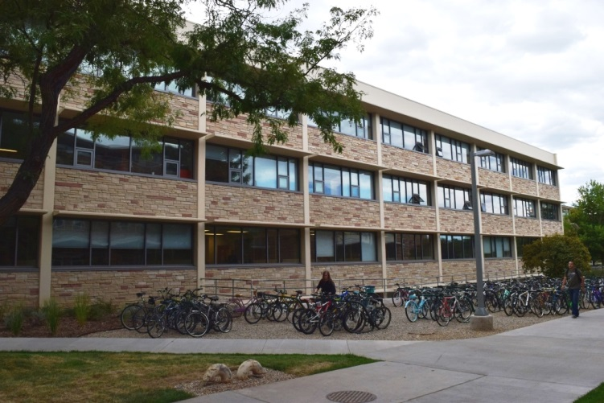
North side of Eddy - After

Slide 23
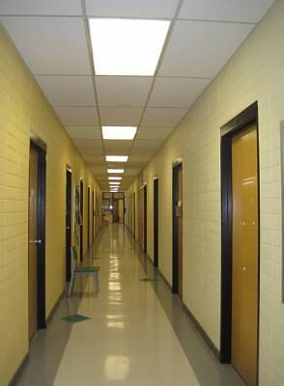
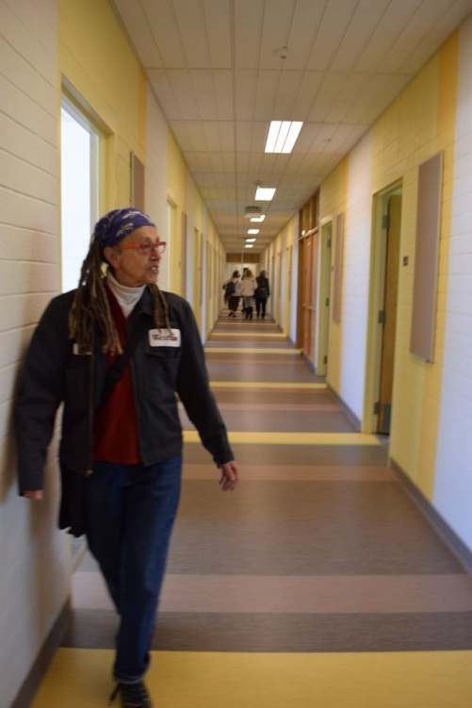
3rd floor Eddy Hallway - Before and After (Hall Monitor Leslee Becker)

Slide 24
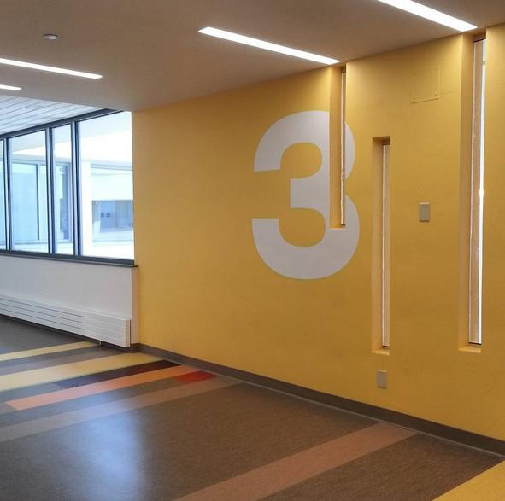

Slide 25
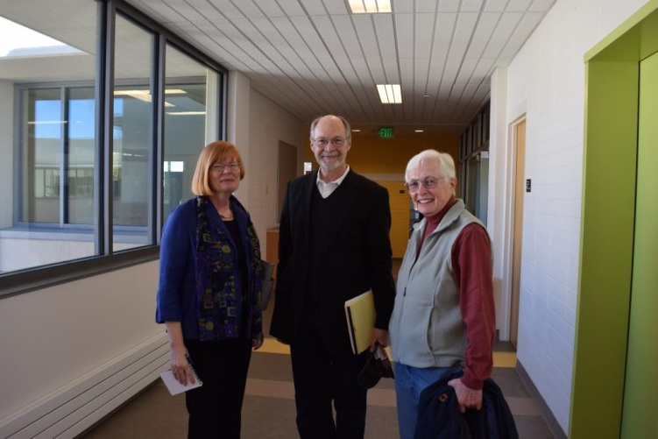
Building Walkthrough, May 2015, (three generations of department chairs – Louann Reid, Bruce Ronda, and Pattie Cowell).

Slide 26
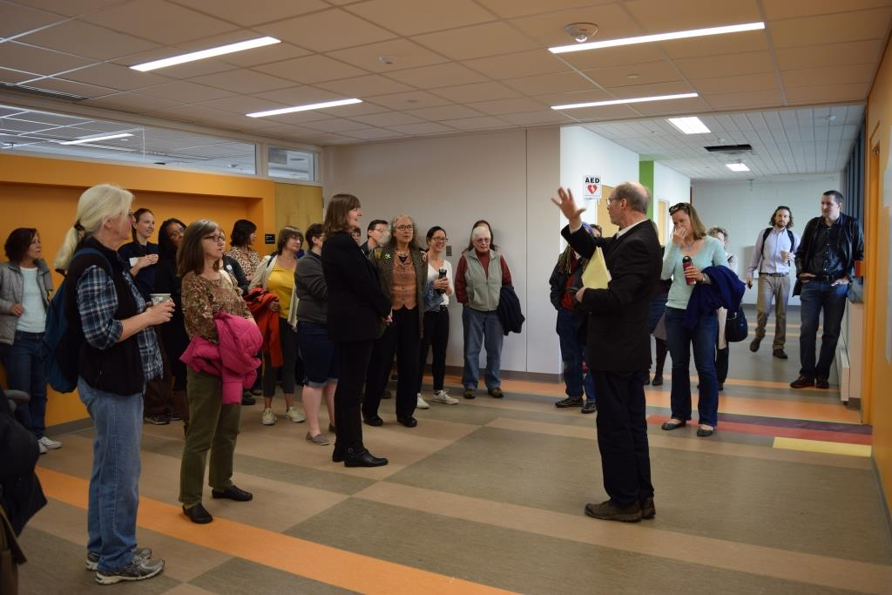
Building Walkthrough, May 2015

Slide 27
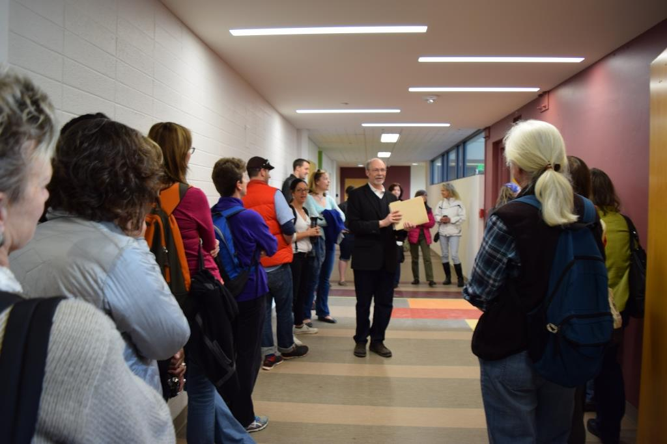
Building Walkthrough, May 2015

Slide 28
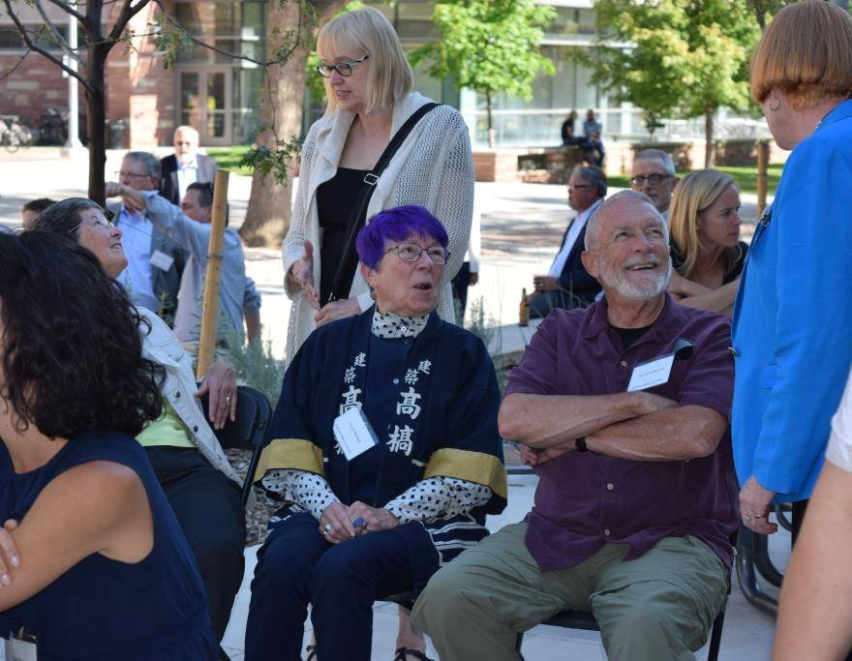
Eddy Hall: Home Again Event - Peggy Lindstrom, Chris Nelson (standing), Carol Mitchell, David Lindstrom, Louann Reid

Slide 29
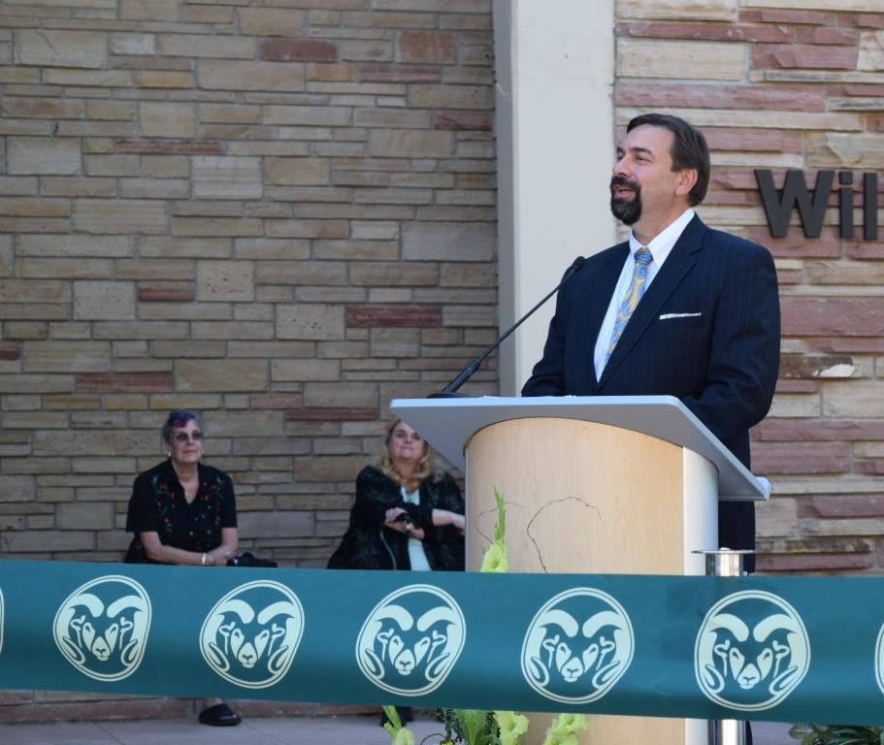
Eddy Hall: Home Again Event - Sandra Eddy (Willard O. Eddy’s daughter), Ann Gill (CLA Dean), and Tony Frank (President of Colorado State University, Chancellor of the CSU System)

Slide 30
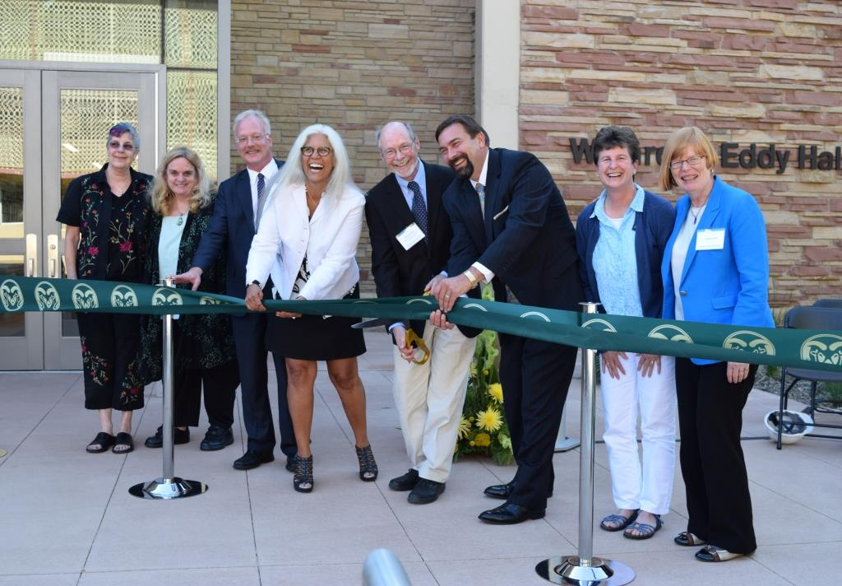
Eddy Hall: Home Again Event - Sandra Eddy (Willard O. Eddy’s daughter), Ann Gill (CLA Dean), John Didier (interim Chair of Philosophy), Irene Vernon (Chair of Ethnic Studies), Bruce Ronda (CLA Associate Dean), Tony Frank (President of Colorado State University and Chancellor of the CSU System), Christina Sutton (Senior Teaching appointment faculty member in the English Department), and Louann Reid (Chair of English)

Slide 31
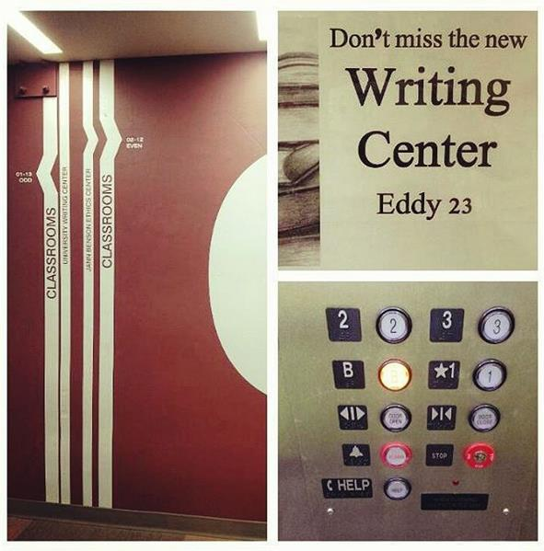
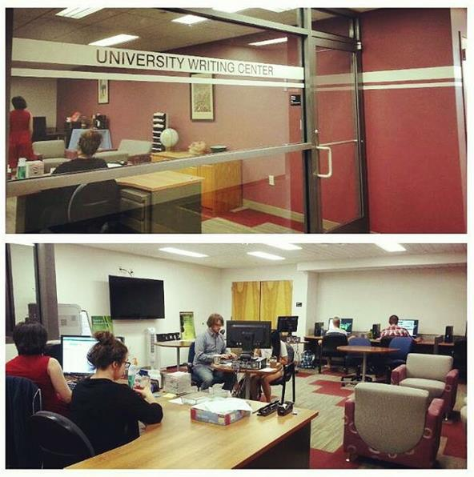
Eddy Spaces: Writing Center

Slide 32
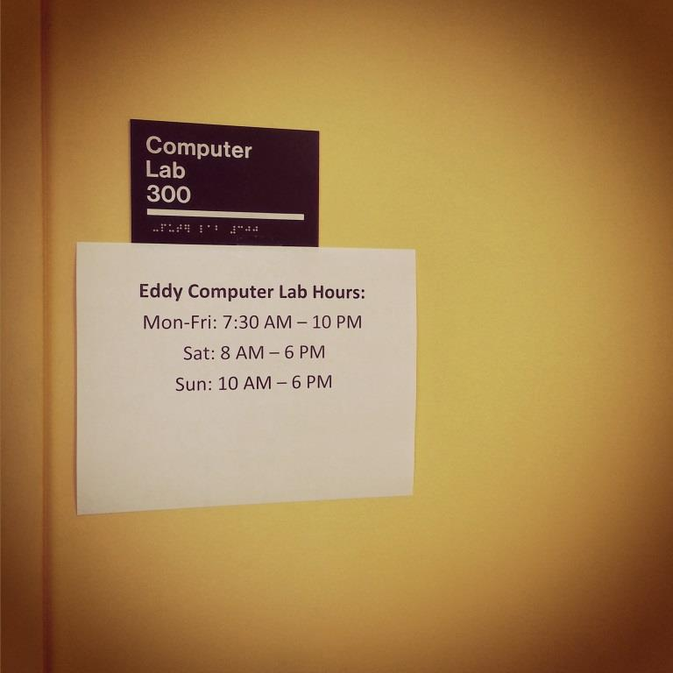
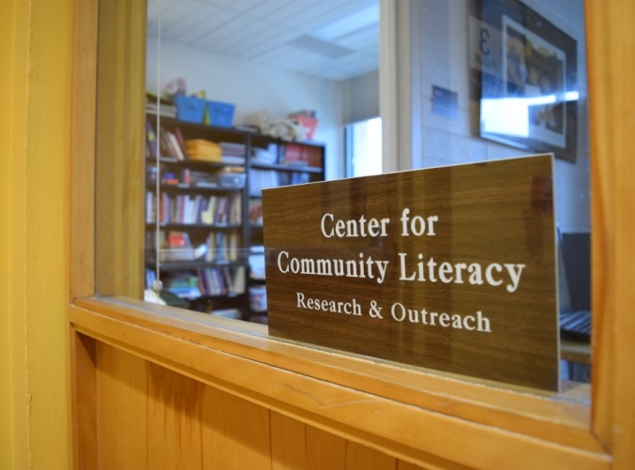
Eddy Spaces: Computer Lab and CLC

Slide 33
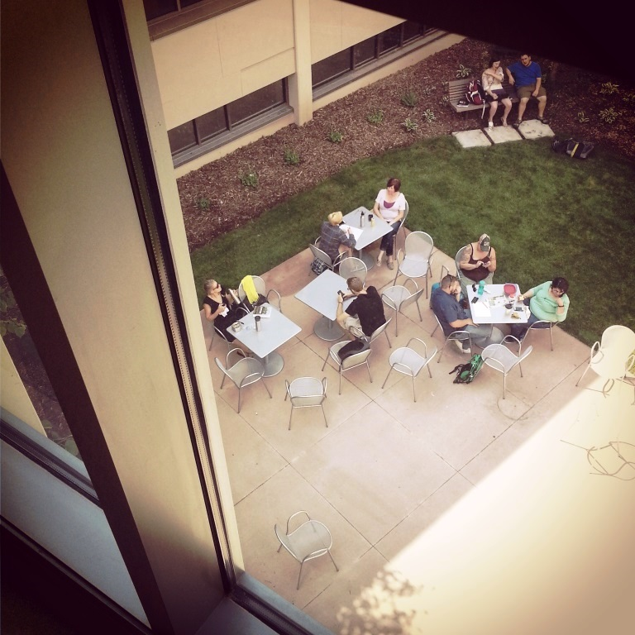
Eddy Spaces: Atrium Patio

Slide 34
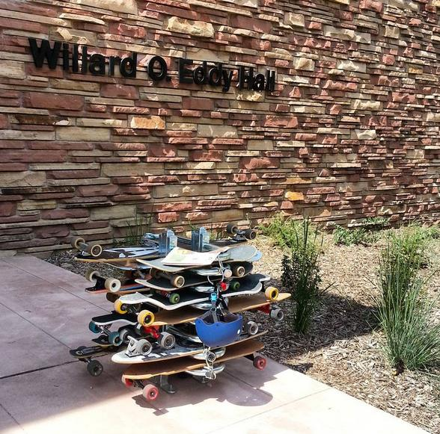
We’ve even got skateboard parking

Slide 35
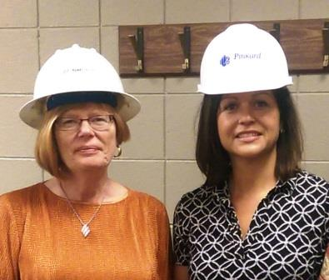
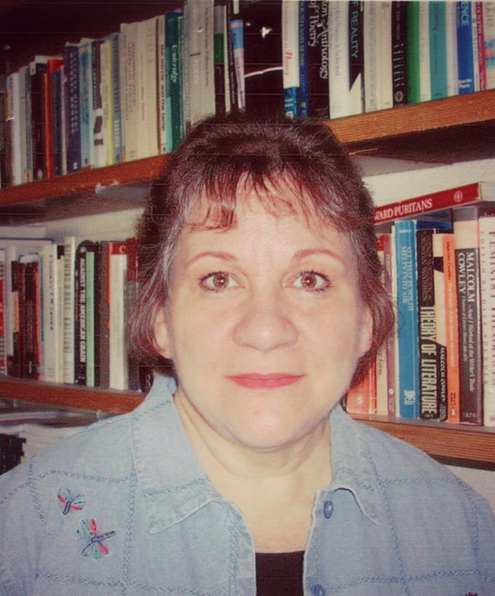
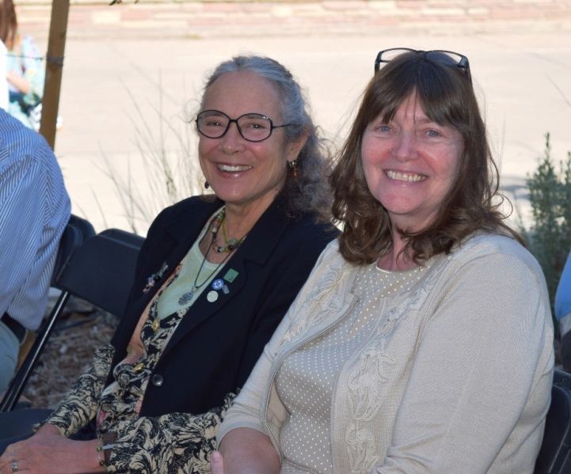
Humans of Eddy: Faculty and Staff
(Louann Reid and Amparo Jeffrey,
Marnie Leonard,
Sue Russell and Sheila Dargon)

Slide 36
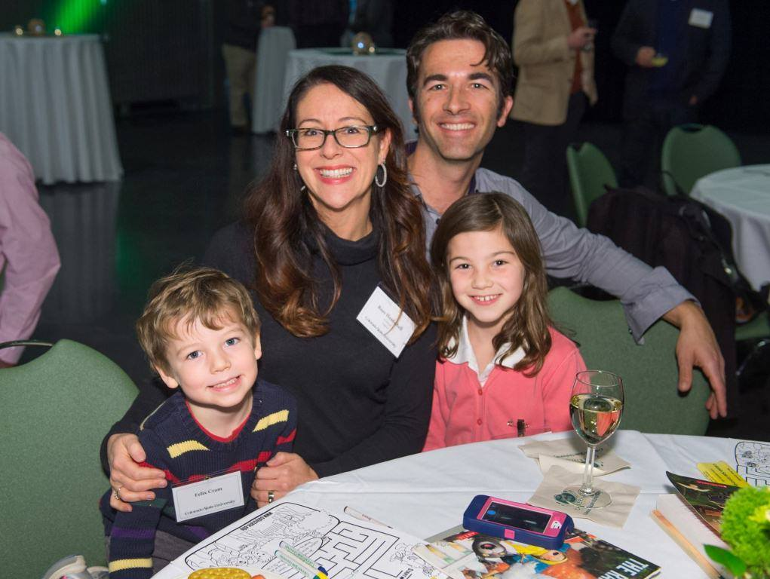
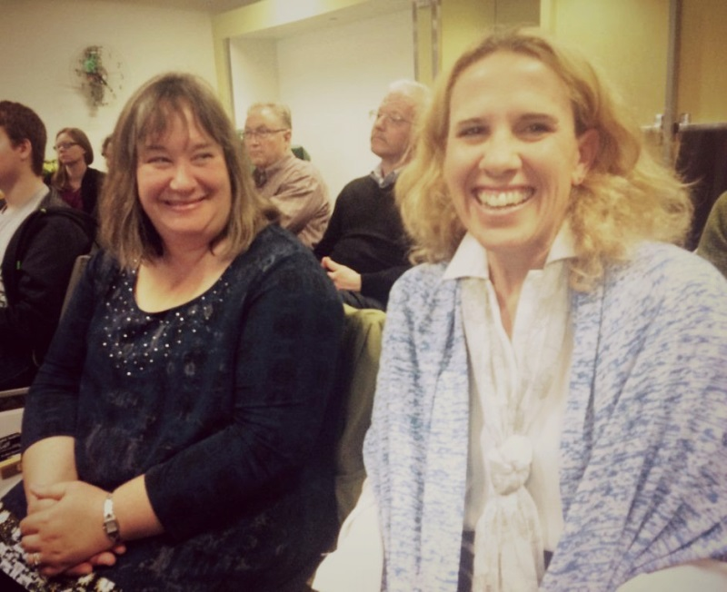
Humans of Eddy - Faculty, Family, and Staff (Roze Hentschell and family attending the Newly Promoted and Tenured Faculty Reception, Tobi Jacobi and Pam Coke, attending Spring CLA awards ceremony where Tobi received a Faculty Development Award and Pam received the CLA Excellence in Teaching Award)

Slide 37
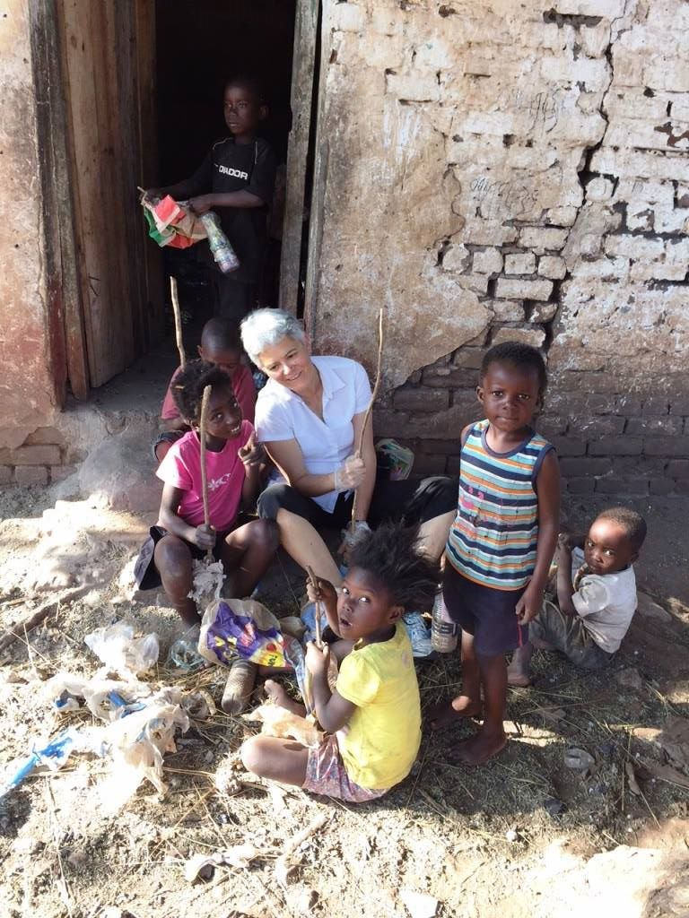
Humans of Eddy: Professor and Graduate Coordinator Ellen Brinks in Zambia, Study Abroad Summer 2015

Slide 38
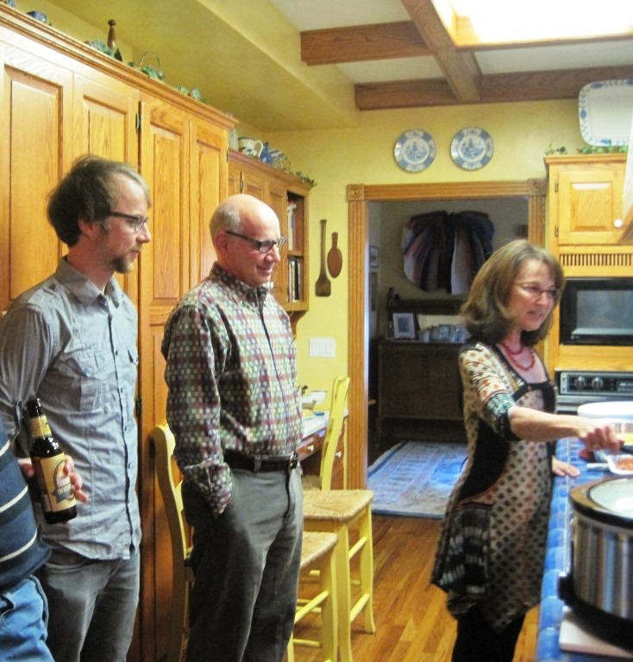
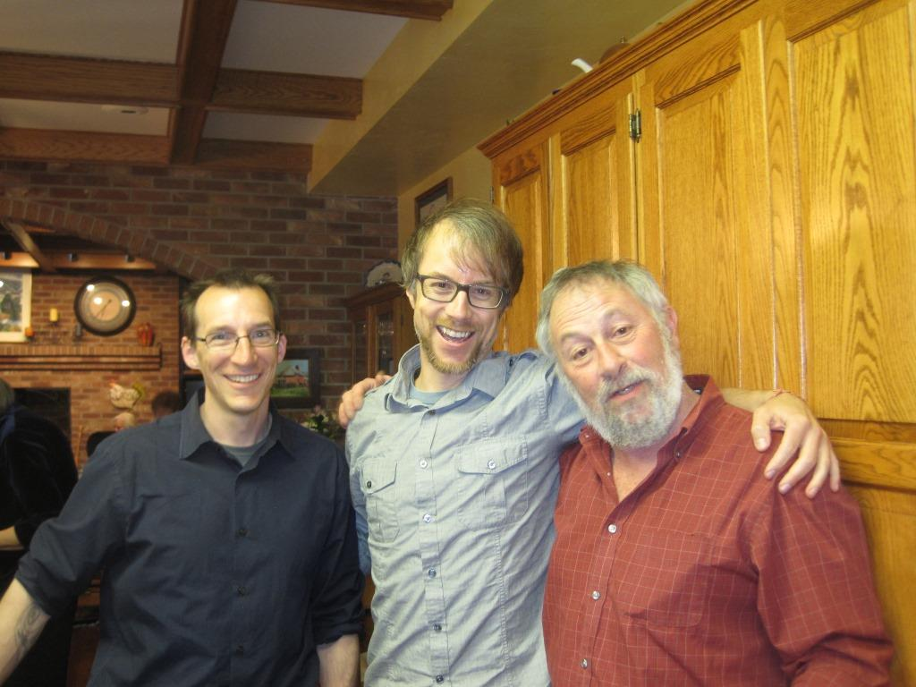
Reading: Justin Hocking (MFA Creative Writing: Fiction, 2002) April 2014 – Justin, Steven Schwartz, and Deanna Ludwin
Todd Mitchell (Assistant Professor, Director of Creative Writing Pedagogy, and MFA Creative Writing: Fiction), Justin, and Professor John Calderazzo

Slide 39
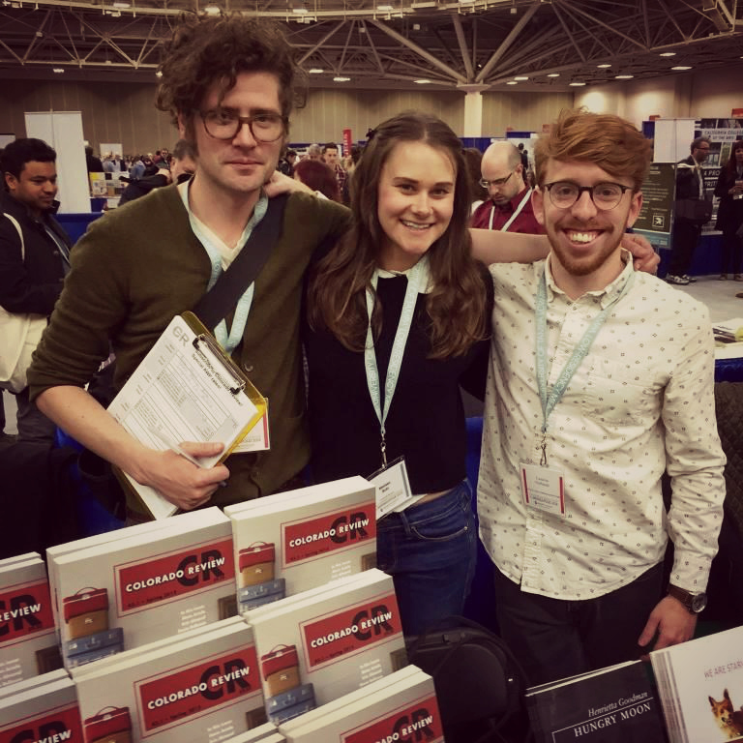
Humans of Eddy: Center for Literary Publishing (CLP) at Spring 2015 Association of Writers and Writing Programs (AWP) Conference - Colorado Review Managing Editor Drew Webster, with Center for Literary Publishing interns Melissa Hohl and Neil FitzPatrick

Slide 40
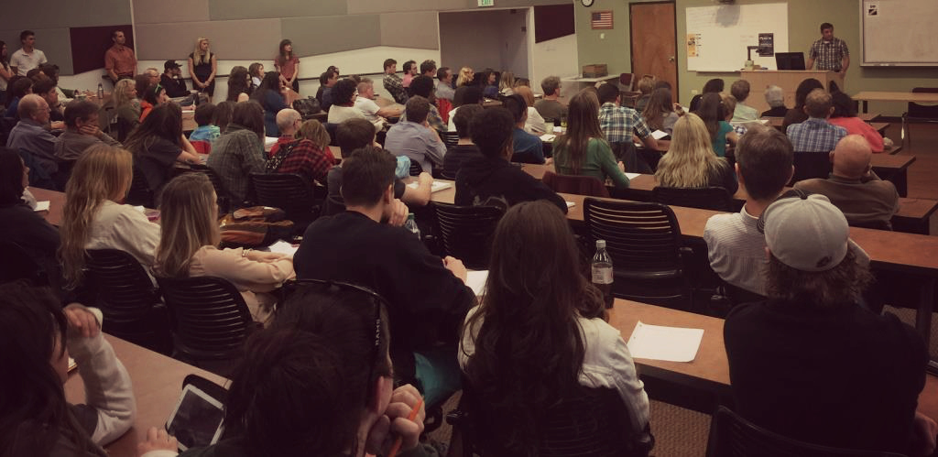
Humans of Eddy: Dan Beachy-Quick’s Monfort Lecture

Slide 41
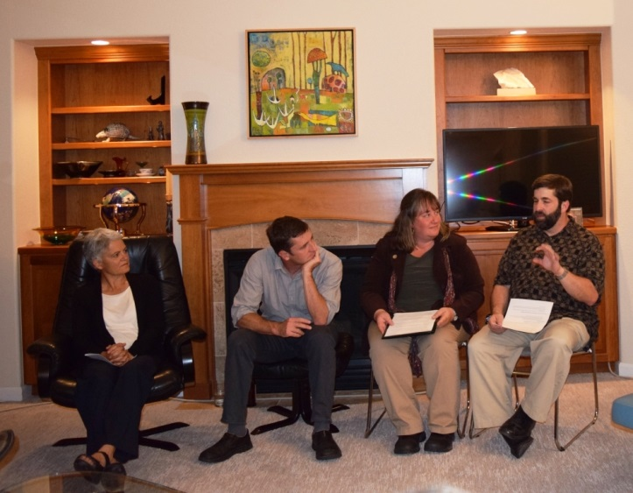
Humans of Eddy: Colloquium – recent presenters Ellen Burns, Dan Beachy-Quick, Tobi Jacobi and Ed Lessor

Slide 42
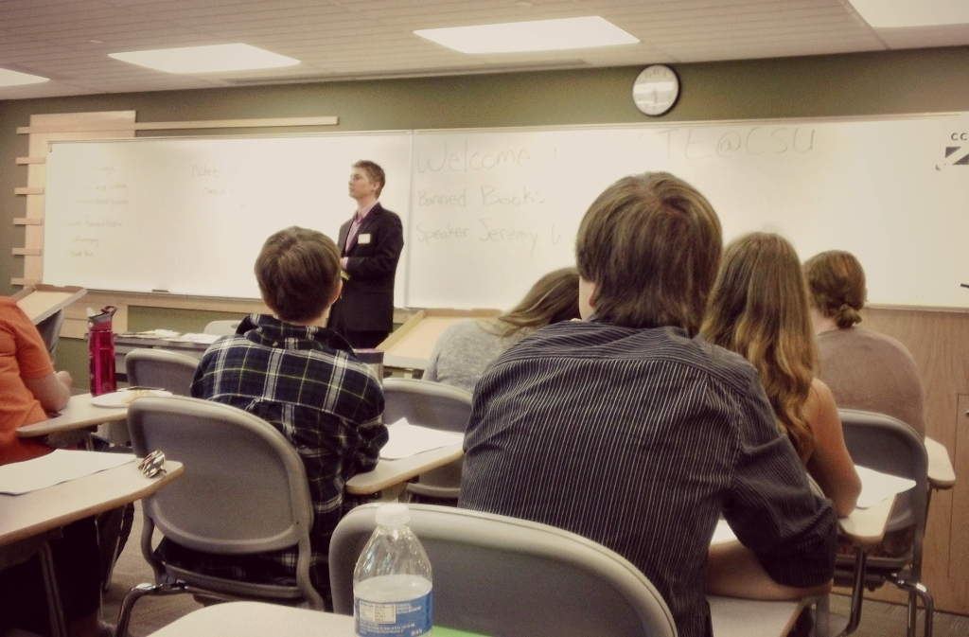
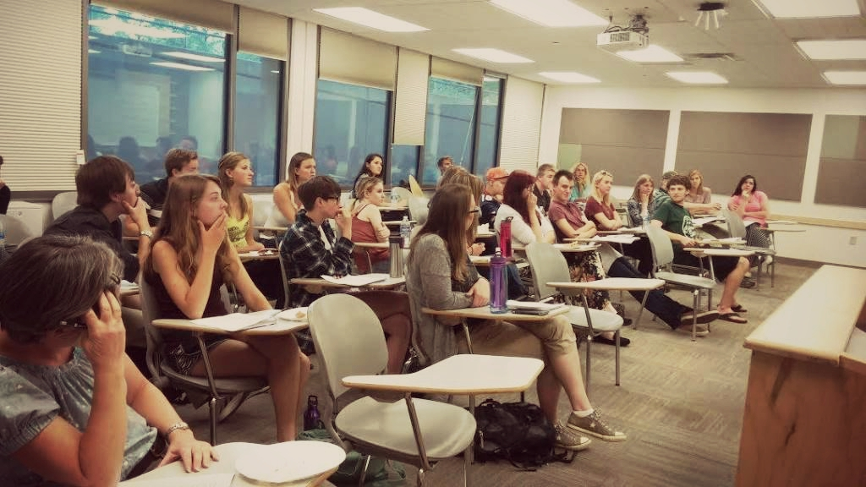
Humans of Eddy: NCTE@CSU – recent event for Banned Books Week

Slide 43

Humans of Eddy: Recent Department Meeting

Slide 44

Bill McBride and Paul De Maret at the 2009 NCTE Convention in Philadelphia, where Bill received the Distinguished Service Award from the National Council of Teachers of English.

Slide 45

Pulitzer-Prize Winning Poet Yusef Komunyakaa (MA Creative Writing 1978) has been selected as the 2015 CLA Honor Alumnus

Slide 46





Department Alumni: Dianne Harper - 1964, Robert King - 1961, Guo Hua (Georgette) Yang – 1994, Doris Goldsmith Melnick – 1968, Justin Dobbin and family - 1997

Slide 47



Department Alumni: Audrey Taylor (2007), Caleb Harrison (2010), Ben Findlay (MFA 2014)

Slide 48

Department Alumni: Joelle Paulson, Shannon Dale, Sam Iacovetto (MA 2014), Amanda Memoli, Lydia Page, Megan Lemming, and Kristie Yelinek

Slide 49

2014 Graduation: English majors Emily Schlehuber, Tara Seyffert, Jeremy Miller, and Tyler Arko.

Slide 50



Humans of Eddy: Gilbert Findlay, John Pratt, Ellen Brinks and Mary Crow

Slide 51

Humans of Eddy: Debby Thompson, Carol Mitchell, Bruce Ronda, and Rosemary Whitaker

Slide 52

Humans of Eddy: Sue Weaver, Leslee Becker, Ellen Brinks, and Cactus May on guitar

Slide 53


Humans of Eddy: Gerry Delahunty, Paul Trembath, Neil Petrie, and Ellen Brinks
Jon Thiem and Terry Sandelin

Slide 54


Humans of Eddy: Marcia Aune, Anne Reid, Kyra Ryan, and Jamie Neufeld
Humans of Eddy:
Irene Vernon and
Cathy Topf

Slide 55

Humans of Eddy: Research Methods E600B takes a break (and a Selfie) at Sweet Sinsations on the last day of classes, Fall 2014. Skyler McAllister in foreground, Emily Lapadure to the immediate right, Ian McCreary, and Whitney Orth. On the opposite side of the table: Shelly Reed, Sue Doe (instructor), Akbi Khan, and Kelsey Hatley.

Slide 56

Humans of Eddy: Professor Roze Hentschell, Associate Professor Aparna Gollapudi, and Assistant Professor Zach Hutchins at the Spring 2015 Lit MA Showcase

Slide 57

Humans of Eddy: Will Winham, Olivia Tracy, Kim Daggett, and Karen Montgomery-Moore, four of the six Literature students who defended or will defend their projects in the academic year 2014-2015, with Professor SueEllen Campbell

Slide 58

Assistant Professor EJ Levy with author Cheryl Strayed, who came to read at CSU for the Creative Writing Reading Series in April 2015

Slide 59

2015 Creative Writing Reading Series upcoming events

Slide 60

We’re on Instagram!
Follow us
@csu_english

Slide 61

We’re on Twitter!
Follow us
@english_csu

Slide 62

We’re on Facebook!
Follow us!

Slide 63






We have a blog! http://english.colostate.edu/blog
And great interns who help us write it,
(English Department Communications Interns, Spring 2014 - Fall 2015)

